Slide 1
Importing Data in R

Slide 2
Outline
read.csv
read.delim
read.table
library("readr")
library("data.table")
library("readxl")

Slide 3
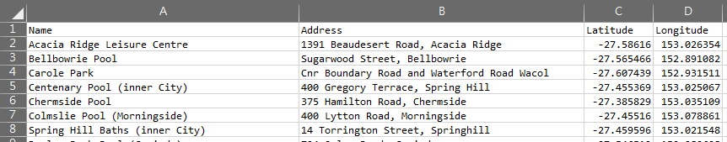

read.csv
# Import swimming_pools.csv: pools
pools <- read.csv("swimming_pools.csv")
# Print the structure of pools
str(pools)

Slide 4
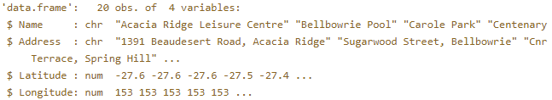
read.csv
# Import swimming_pools.csv correctly: pools
pools <- read.csv("swimming_pools.csv", stringsAsFactors = FALSE)
# Check the structure of pools
str(pools)

Slide 5
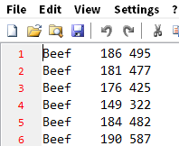
read.delim
# Import hotdogs.txt: hotdogs
hotdogs <- read.delim("hotdogs.txt", header = FALSE)
# Summarize hotdogs
summary(hotdogs)

Slide 6
read.table
# Import the hotdogs.txt file: hotdogs
hotdogs <- read.table("hotdogs.txt",
sep = "\t",
col.names = c("type", "calories", "sodium"))
# Call head() on hotdogs
head(hotdogs)

Slide 7
Exercise
# Finish the read.delim() call
hotdogs <- read.delim("hotdogs.txt", header = FALSE, col.names = c("type", "calories", "sodium"))
# Select the hot dog with the least calories: lily
lily <- hotdogs[which.min(hotdogs$calories), ]
# Select the observation with the most sodium: tom
tom <- hotdogs[which.max(hotdogs$sodium), ]
# Print lily and tom
lily
tom

Slide 8
library("readr")

Slide 9
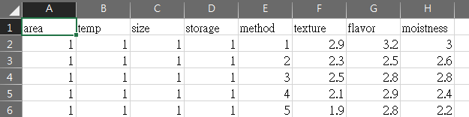
read_csv
# Load the readr package
install.packages("readr")
library("readr")
# Import potatoes.csv with read_csv(): potatoes
potatoes <- read_csv("potatoes.csv")

Slide 10
read_tsv
library("readr")
# Column names
properties <- c("area", "temp", "size", "storage", "method",
"texture", "flavor", "moistness")
# Import potatoes.txt: potatoes
potatoes <- read_tsv("potatoes.txt", col_names = properties)
# Call head() on potatoes
head(potatoes)

Slide 11
read_delim
library("readr")
properties <- c("area", "temp", "size", "storage", "method",
"texture", "flavor", "moistness")
# Import potatoes.txt using read_delim(): potatoes
potatoes <- read_delim("potatoes.txt", delim = "\t", col_names = properties)
# Print out potatoes
potatoes

Slide 12
skip and n_max
skip:the number of lines you're ignoring
n_max: the number of lines you're actually importing.
library("readr")
# Column names
properties <- c("area", "temp", "size", "storage", "method",
"texture", "flavor", "moistness")
potatoes_fragment <- read_tsv("potatoes.txt", skip = 6, n_max = 5, col_names = properties)
potatoes_fragment

Slide 13
library("data.table") library("readxl")

Slide 14
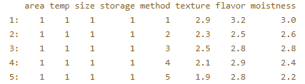
library(data.table)
potatoes <- fread("potatoes.csv", select = c(6, 8))
plot(potatoes$texture, potatoes$moistness)

Slide 15
# Load the readxl package
library(readxl)
# Print out the names of both spreadsheets
excel_sheets("urbanpop.xlsx")

Slide 16
library(readxl)
pop_1 <- read_excel("urbanpop.xlsx", sheet = 1)
pop_2 <- read_excel("urbanpop.xlsx", sheet = 2)
pop_3 <- read_excel("urbanpop.xlsx", sheet = 3)
pop_list <- list(pop_1, pop_2, pop_3)
pop_list

Slide 17
paste("Hello", "World", sep = "-")
paste0("Hello", "World")
library(readxl)
# Import Excel sheet of urbanpop_nonames.xlsx (R gives names): pop_a
pop_a <- read_excel("urbanpop_nonames.xlsx", col_names = FALSE)
# Import Excel sheet of urbanpop_nonames.xlsx (specify col_names): pop_b
cols <- c("country", paste0("year_", 1960:1966))
pop_b <- read_excel("urbanpop_nonames.xlsx", col_names = cols)
head(pop_a)
head(pop_b)

